Slide 1
”Lists”
By Brandon Tarney
JHU 605.487
4/26/2018

Slide 2
About My App
Todo/lists app (like reminders)
Basic concepts/data-flow:
Lists have 0 – N todos
Todos each belong to 1 or more lists
You can select any List to display its Todos
Smart Lists have 0 - N lists
Smart lists allow you to combine lists, and display only the Todos which are present in ALL lists in the smart list
A smart list composed of lists “homework” and “top priority” will show ONLY “top priority homework” todos
**IGNORE THE FIRST VIEW – it’s for debugging & playing w/Core Data (just tap “MAIN APP”)**

Slide 3
UI Concept Art
The concept of a “view” and of a “tag” were combined into the concept of a list.

Slide 4
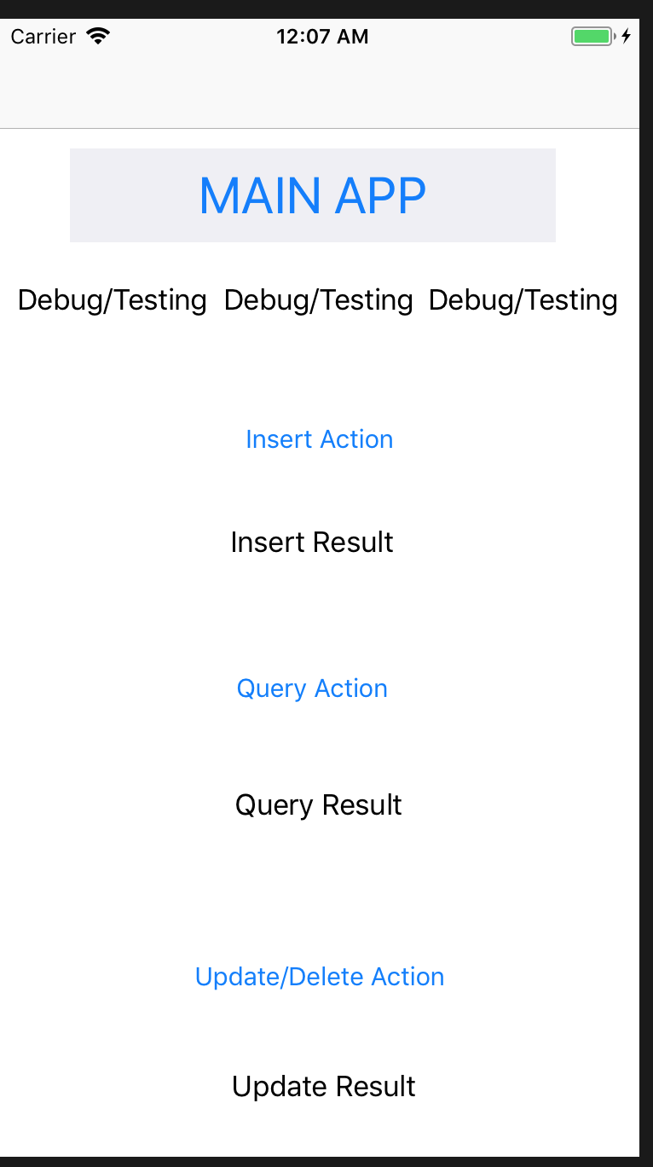
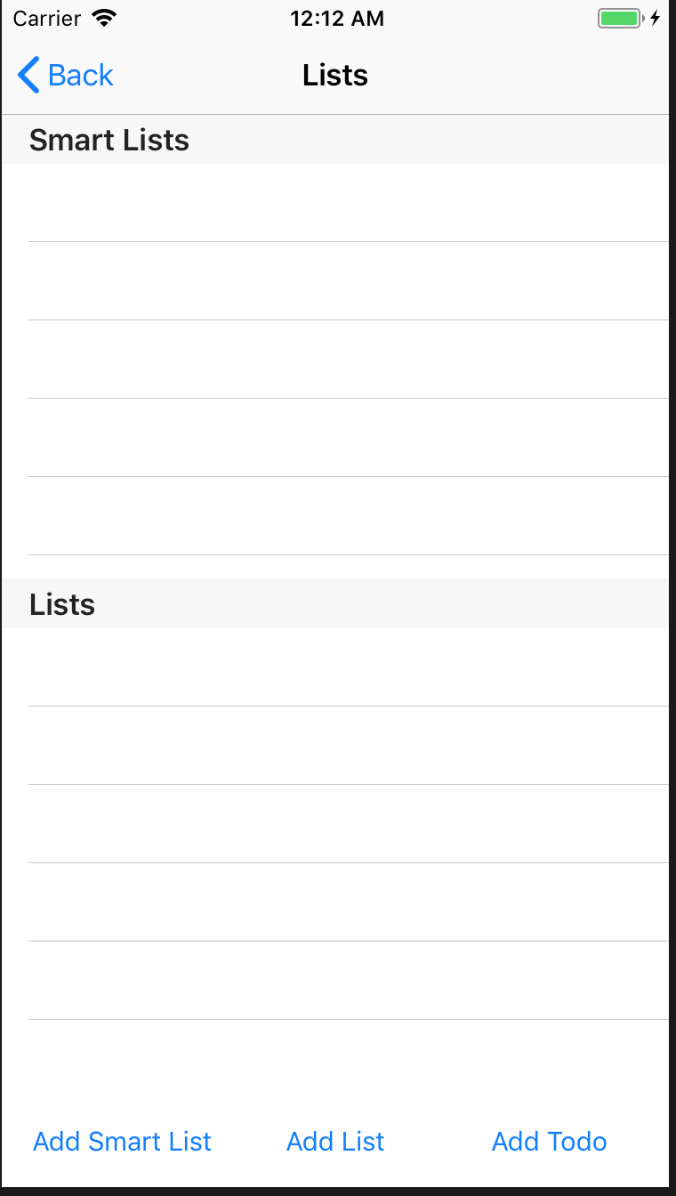
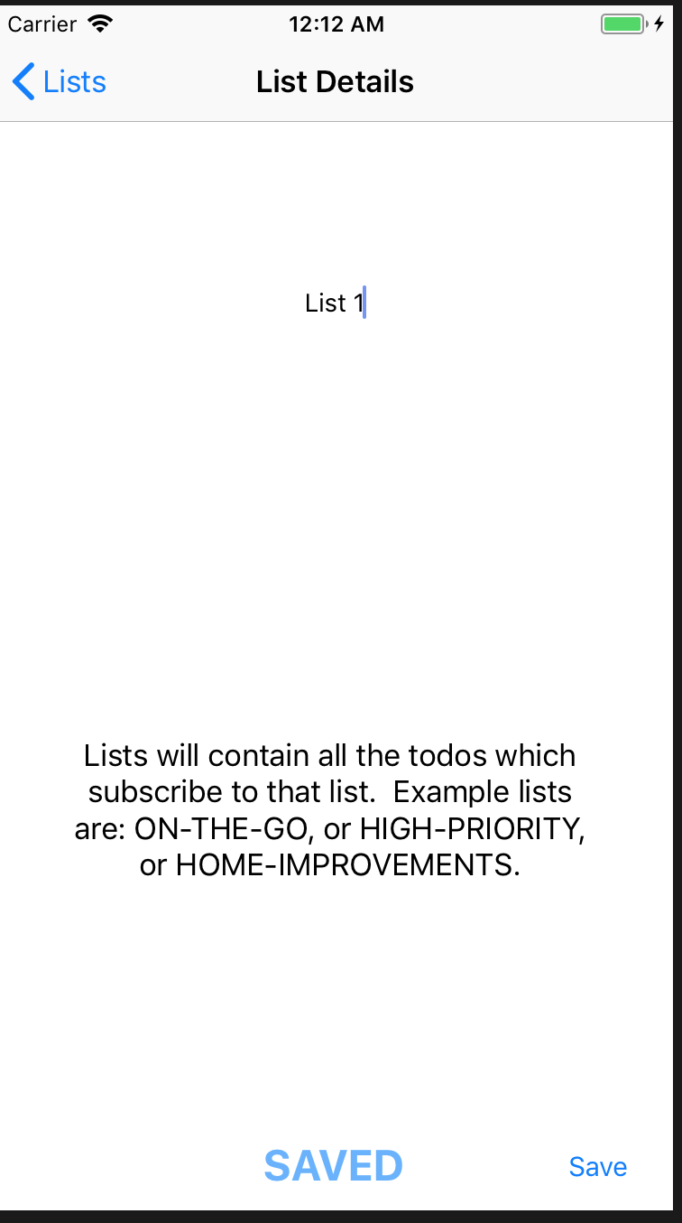
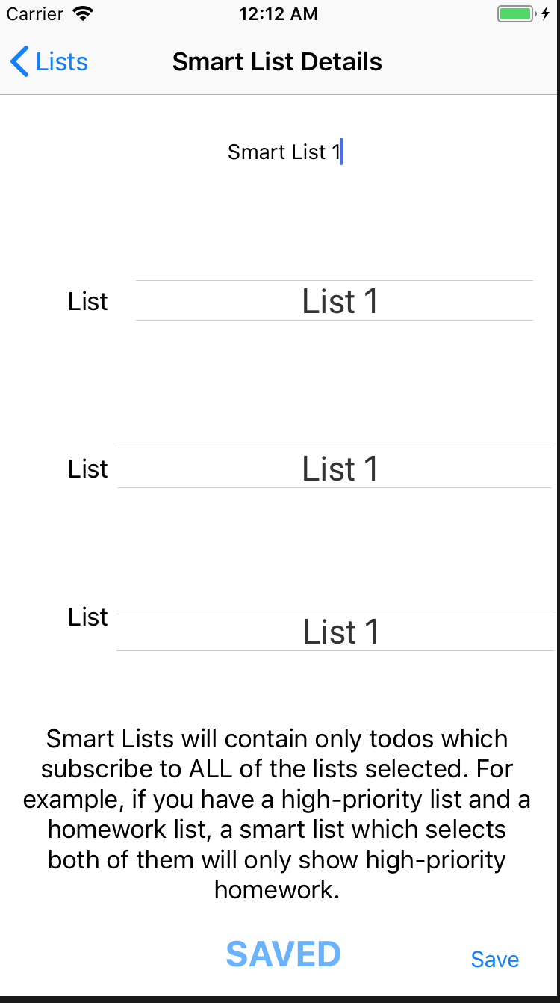
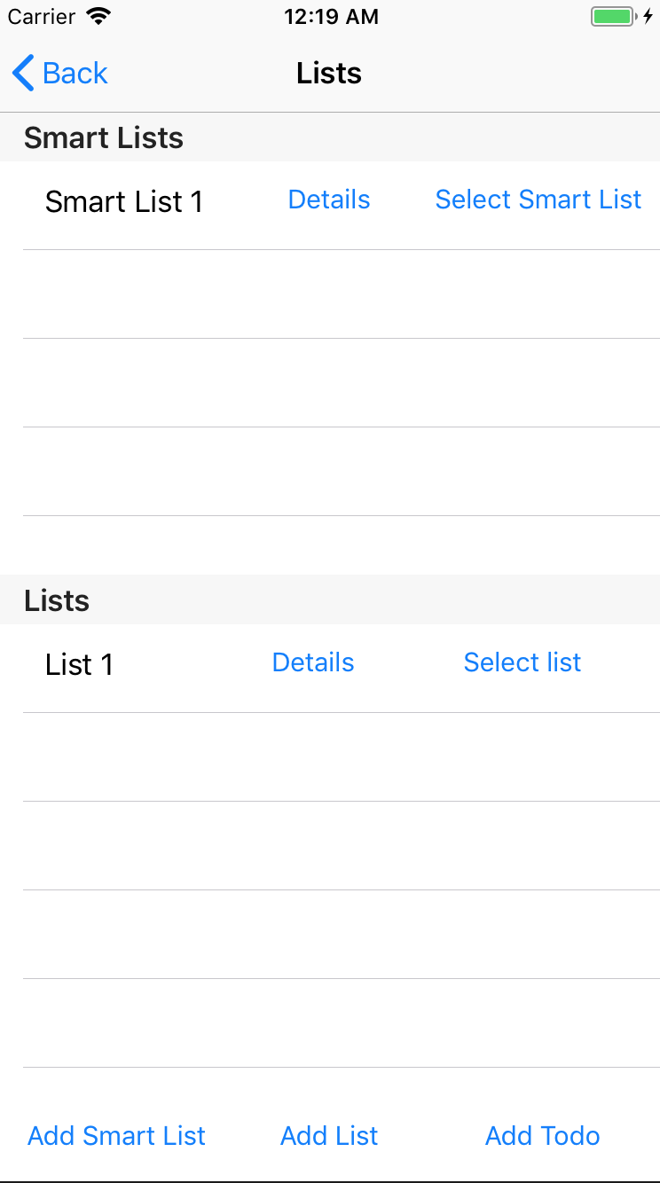
App UI & General Storyboard
TESTING ONLY

Slide 5
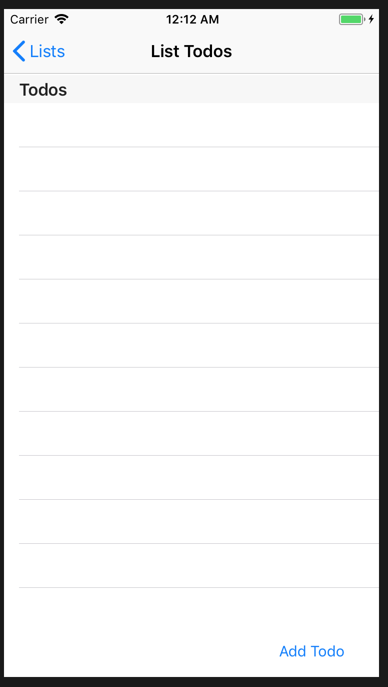
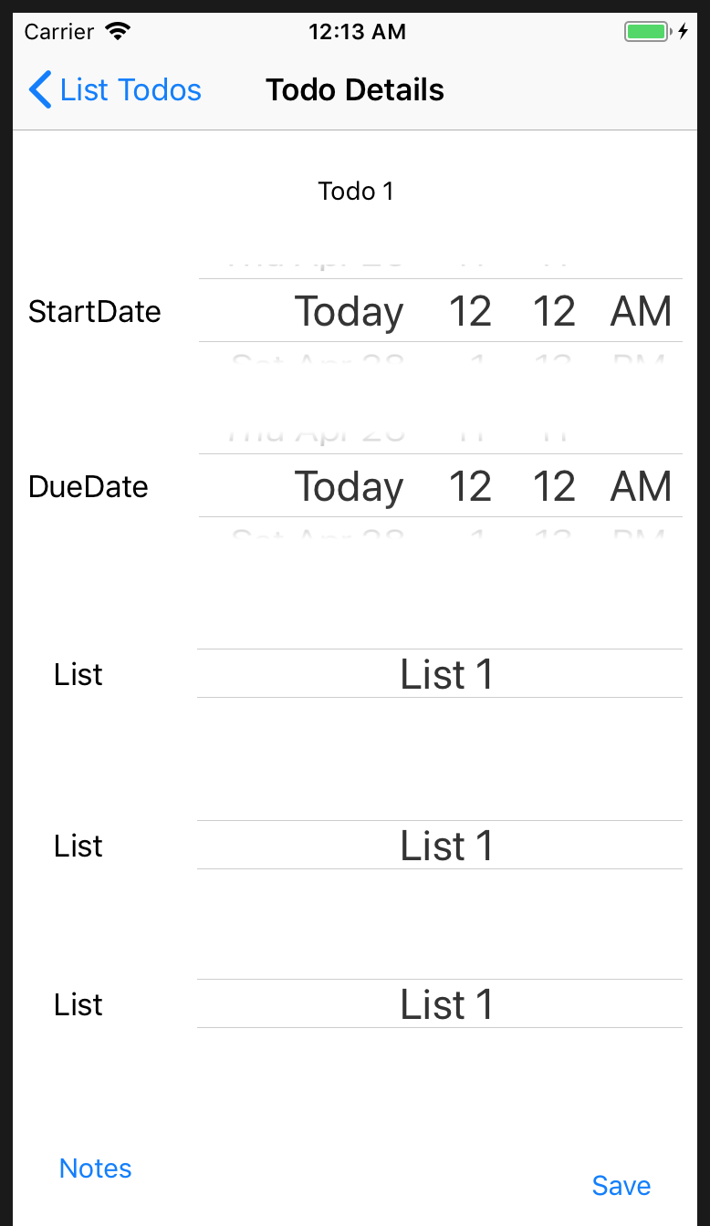
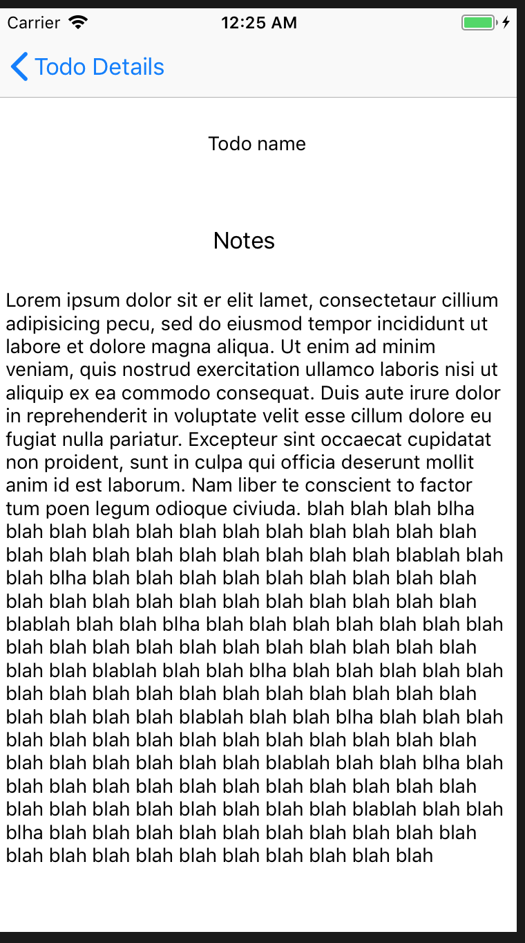
App UI & General Storyboard (Cont.)
Incomplete: this screen will show a given list todos

Slide 6
State of the App
Working
Data Model (Core Data)
Data flow (more or less)
UI
Not Working:
Todos displayed for each list
Several buttons/segues are not complete
i.e. selecting the “details” button on any list should present you with the list and the ability to edit this list but now it just segues to the general add new item view
No Constraints
Please view this app in portrait-mode of iPhone 8/8+
No Gestures, Notifications, App Icon

Slide 7
iOS Concepts Used
UINavigationViewController
UITableViewController
Custom UITableViewCell
UIComboPicker
Segues (programmatic & interface-builder derived)
Constraints
Core Data
Predicates/complex queries
Data model builder & classes
Relationships, 1-many, many-many
Extensions
Gestures (NOT IMPLEMENTED YET)
Notifications (NOT IMPLEMENTED YET)
3d Touch (NOT IMPLEMENTED YET)

Slide 8
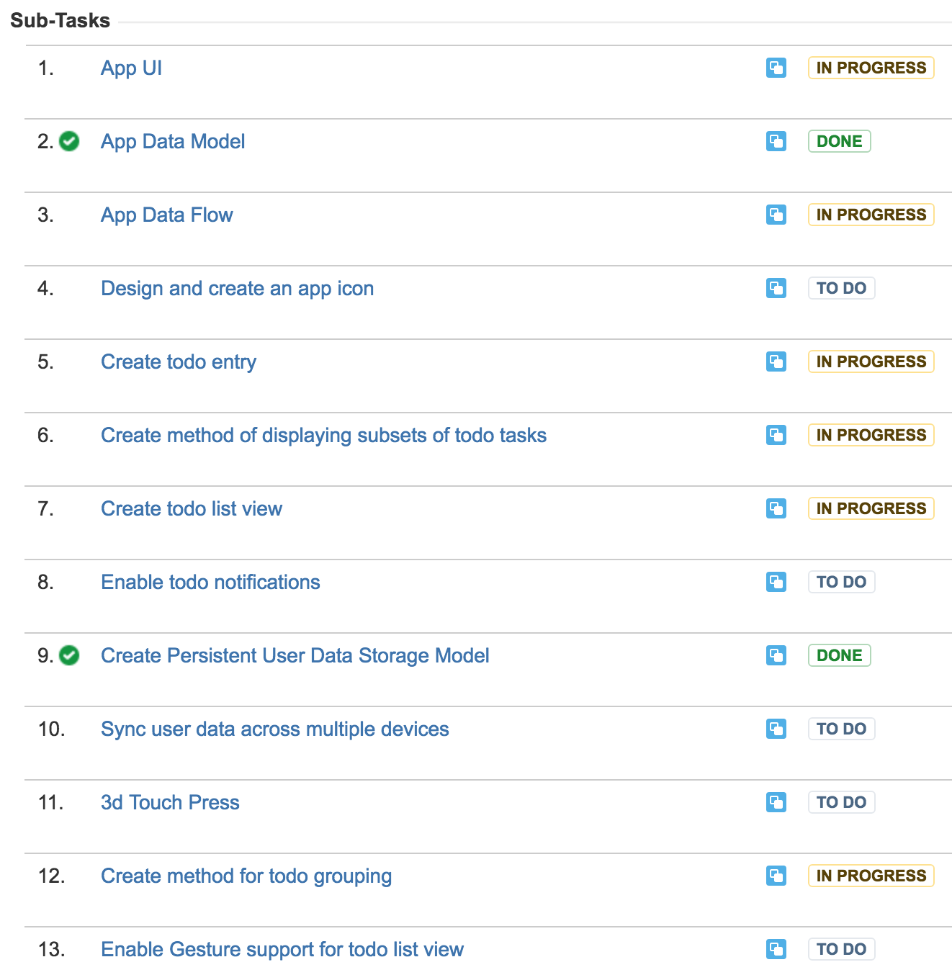
Status/JIRA
Mostly going as planned
UI & amount of Views + segues is taking longer than expected
Would like to add gestures and notification support, but NOT sure if other features, like iCloud syncing will be completed

Slide 9
Feedback
Does the app’s flow make sense?
Do the concepts make sense (lists, smart lists, and todos?)
What other kind of data would you store in a TODO and/or what other kind of UI controls would you prefer
For instance, I use a lot of UIComboPickers right now…..
What should I call this app?! Right now I’m thinking of something like “Lists” or “Lists of Lists” or “Listless” or “Limitlist”…..yeah not very creative

